Slide 1

Datenintegration – 2nd. Phase
Johannes Gesk
Niklas Standop

Slide 2
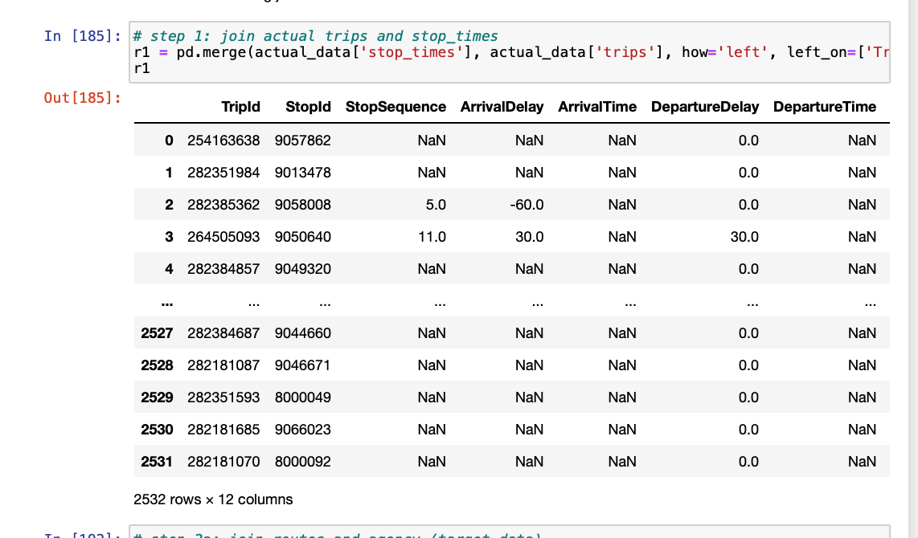
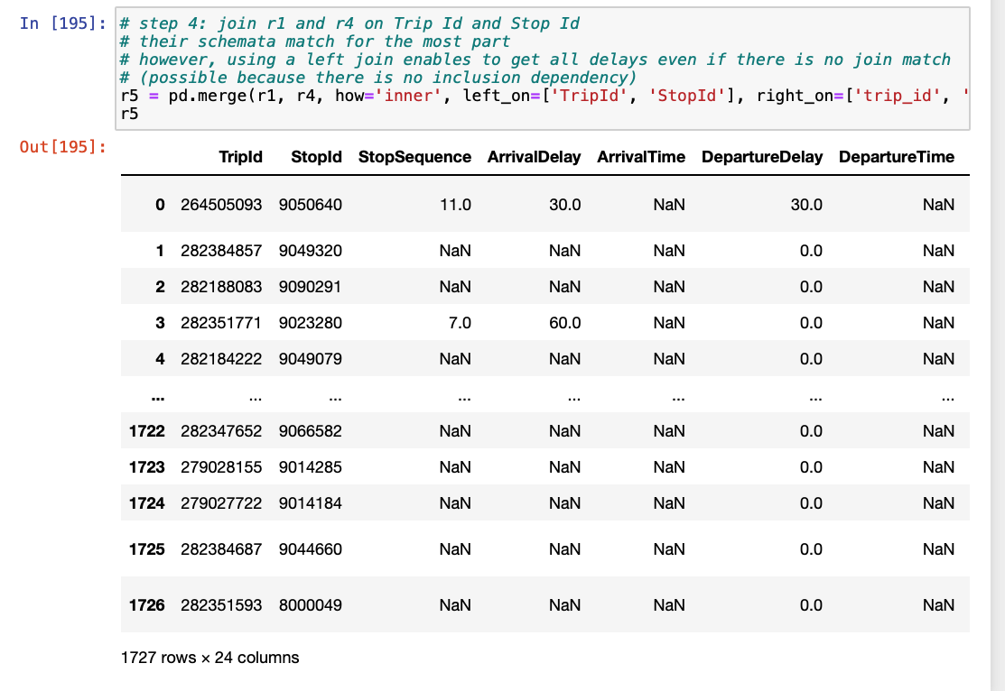
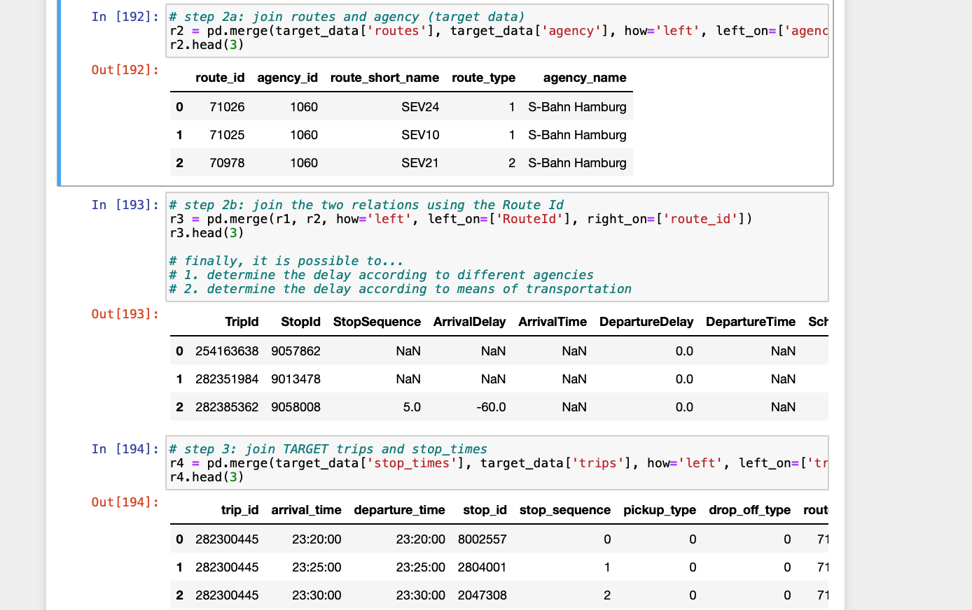
UCC Discovery Steps
Step 1
Step 4
Step 2/3

Slide 3
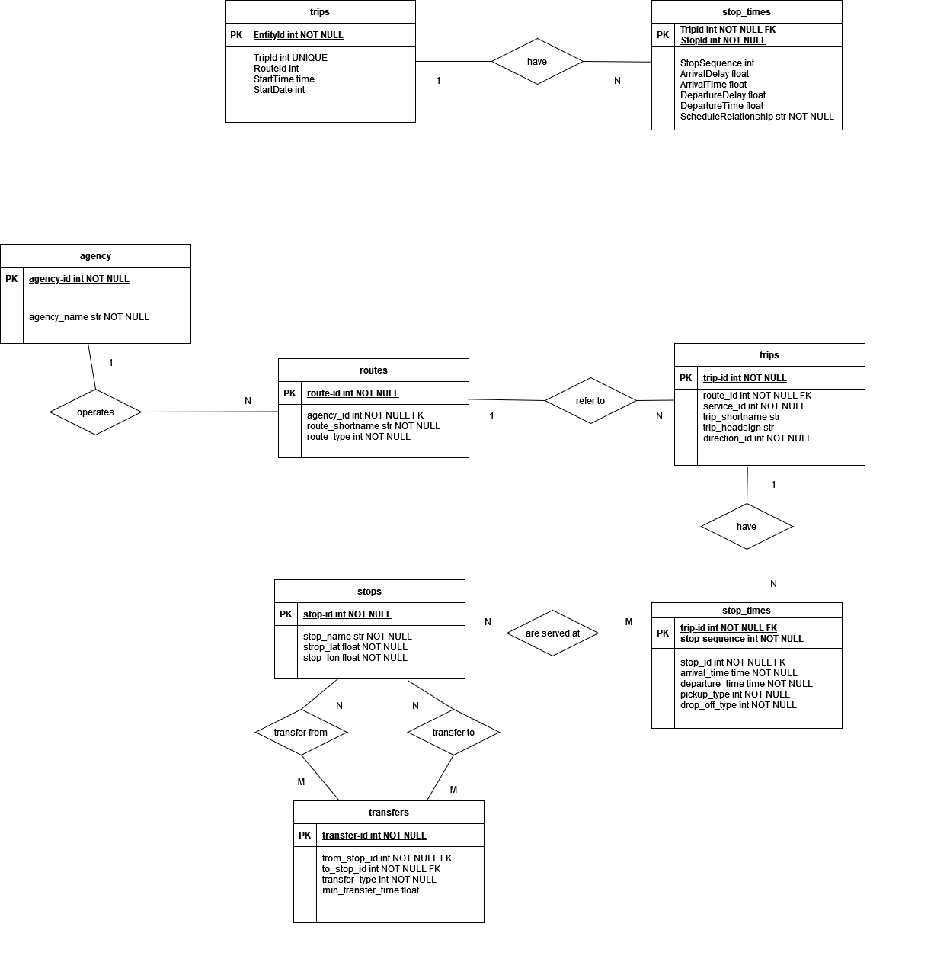
Current status on ER model

Slide 4
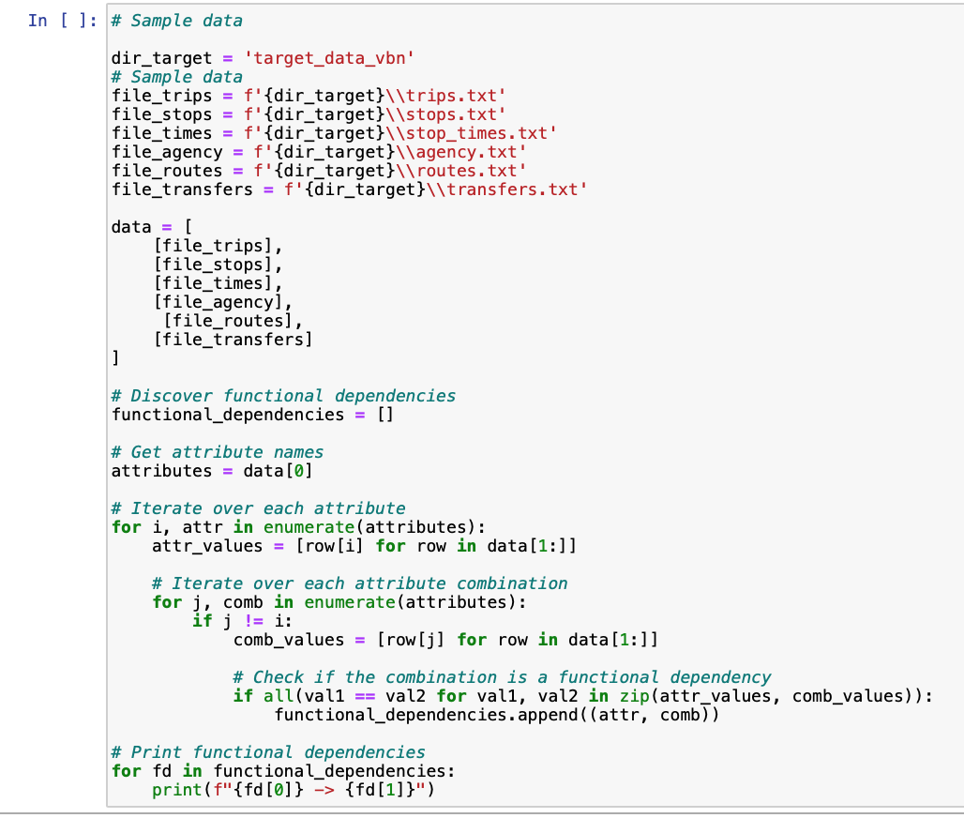
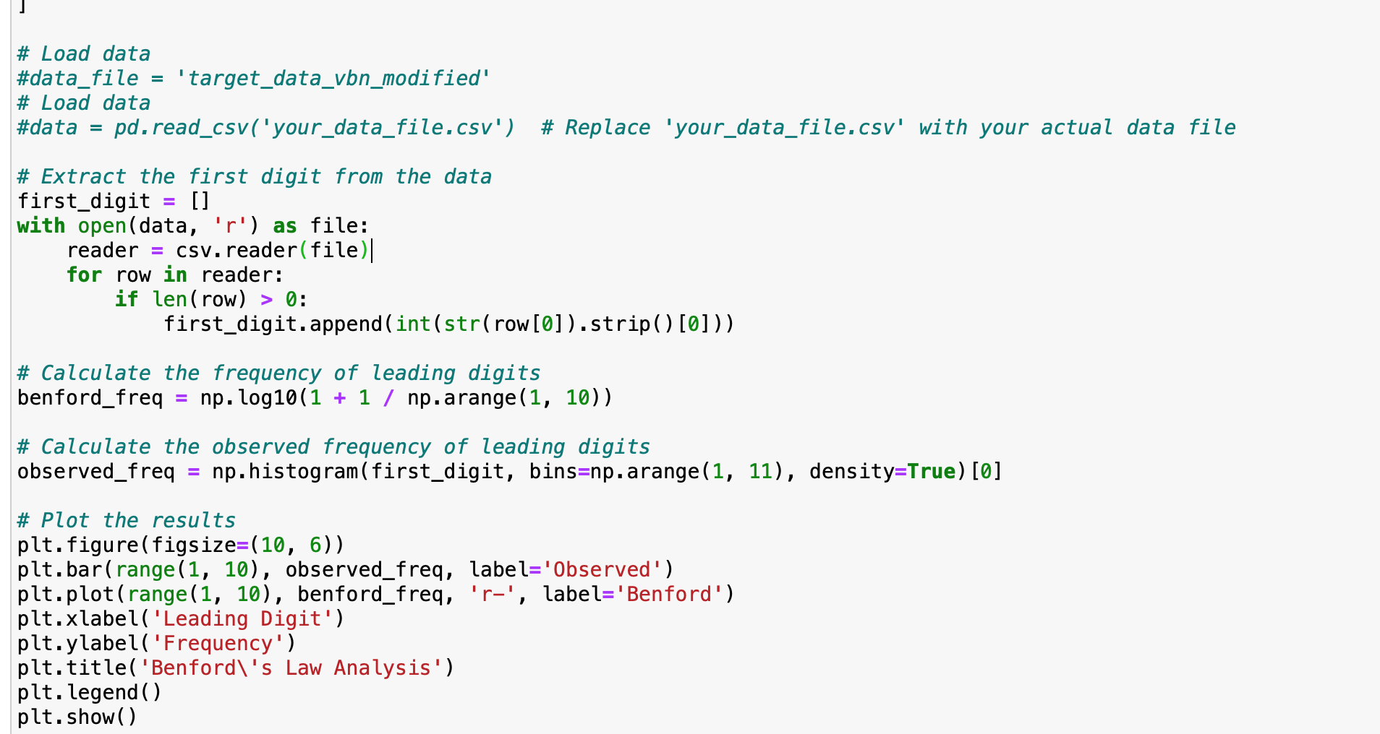
Data profiling – functional dependencies
Data profiling – functional dependencies
Data profiling – Benfords Law Analysis

Slide 5
Next up:
Find further algorithms to get the solution for the showcase
Integration into showcase
Gathering further datasets

